Slide 1

EV CHARGING STATION ANALYSIS

Slide 2
About me
Hi, I'm Mohammed Raashid. I am currently pursuing my graduation in Computer Science & Engineering from Bearys Institute of Technology, Mangalore. During my final year internship, I chose to focus on building my skills in the field of Data Science.
As part of this journey, I developed a strong foundation in key tools and technologies such as Python, Exploratory Data Analysis (EDA), Power BI, and SQL.
linked in: https://www.linkedin.com/in/mohammed-raashid-
github: https://github.com/rashid249

Slide 3
BUSINESS OBJECTIVES:
To dive deep into how EV charging stations are spread across different states in India and understand regional trends.
To track how fast EV charging infrastructure is growing over time—and where it's booming the most.
To uncover insights that can help boost smarter EV adoption and better planning for a greener tomorrow.

Slide 4
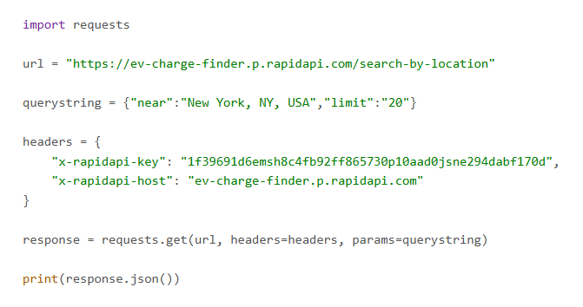
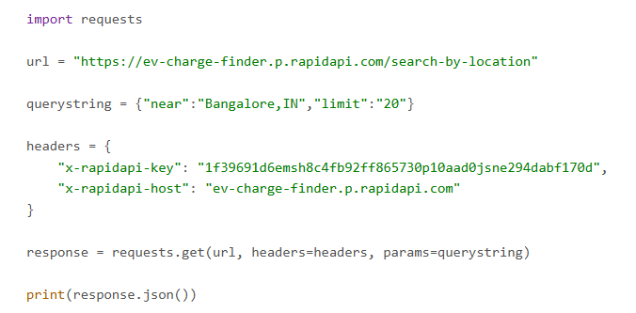
Web Scraping:
While working on web scraping, I used a platform called RapidAPI, where I selected an API named "EV Charge Finder.“
After retrieving the data, I ended up with a database containing 677 rows and 28 columns.
Code of API:

Slide 5
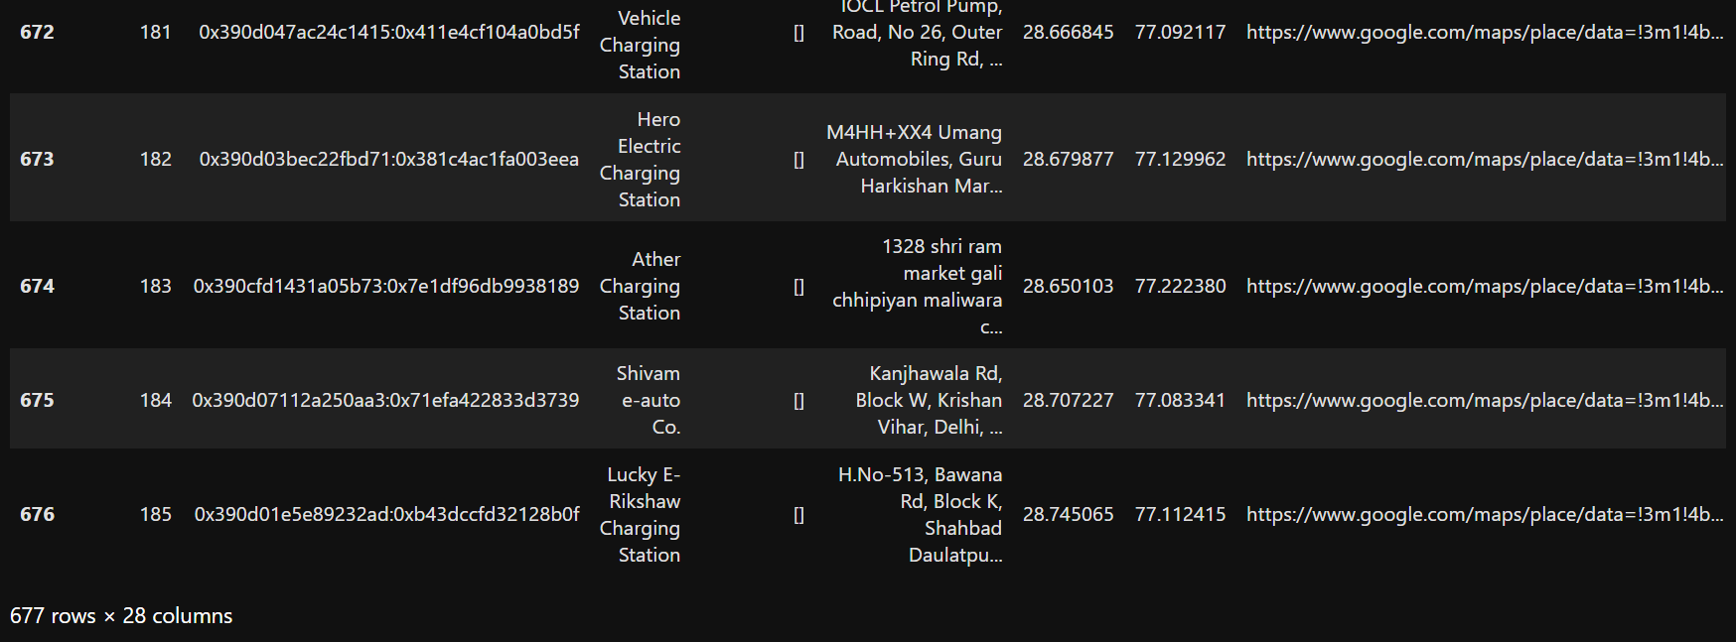
Raw dataset obtained soon after scraping:

Slide 6
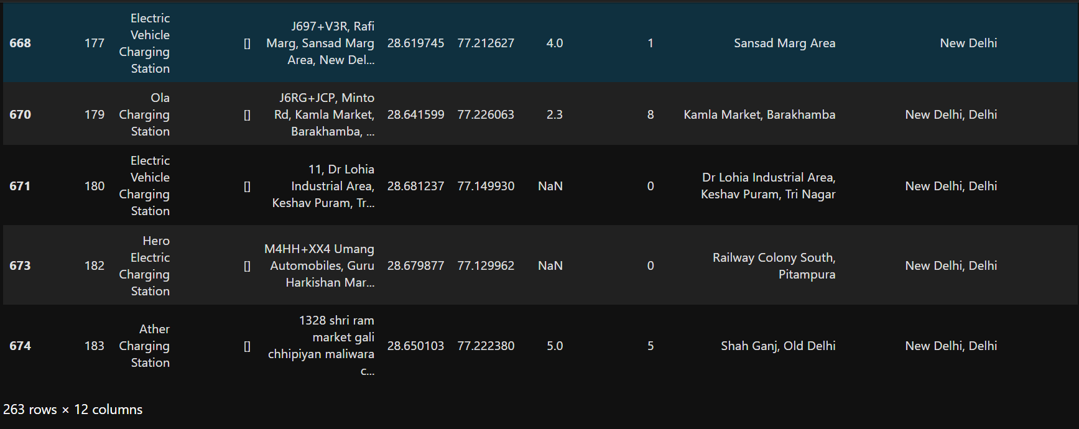
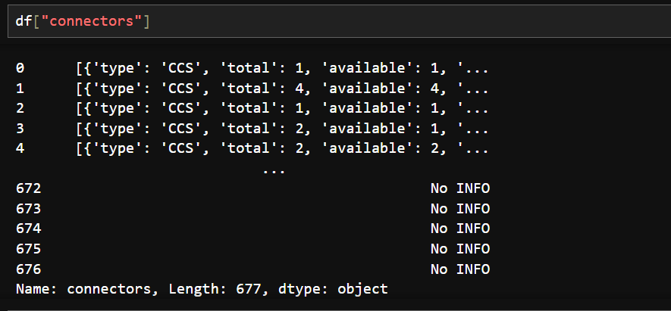
Challenges faced while scaping the Data:
During the data cleaning process, there were additional columns containing irrelevant information, which were removed.
Some columns also had multiple pieces of data combined into a single field, so they were separated accordingly.
Dataset consist of Null values & Irrelevant columns
Single column with multiple values.

Slide 7
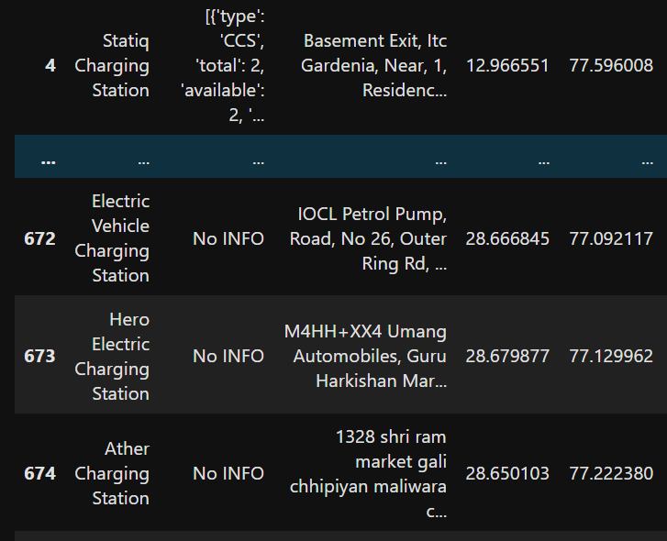

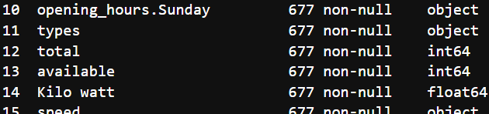
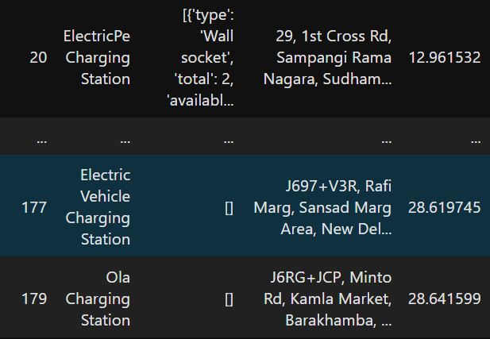

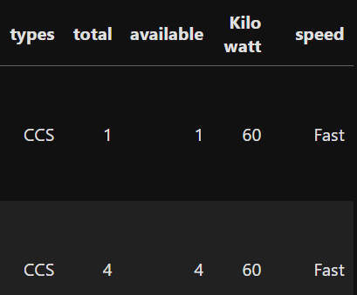
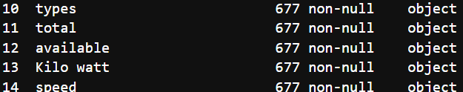
Challenges Addressed:
Missing or null values were replaced with the label “No INFO."
Missing numerical values were filled with 0 to maintain consistency.
Column data types were also updated to their appropriatand analysis.
Combined data entries were separated using regular expressions.

Slide 8
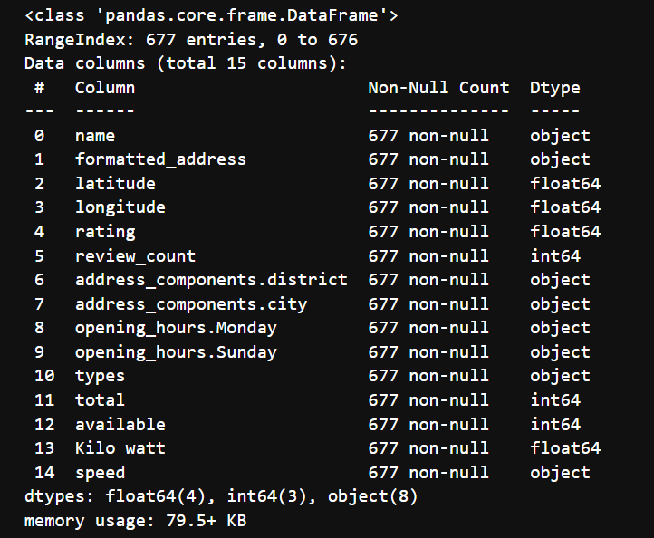
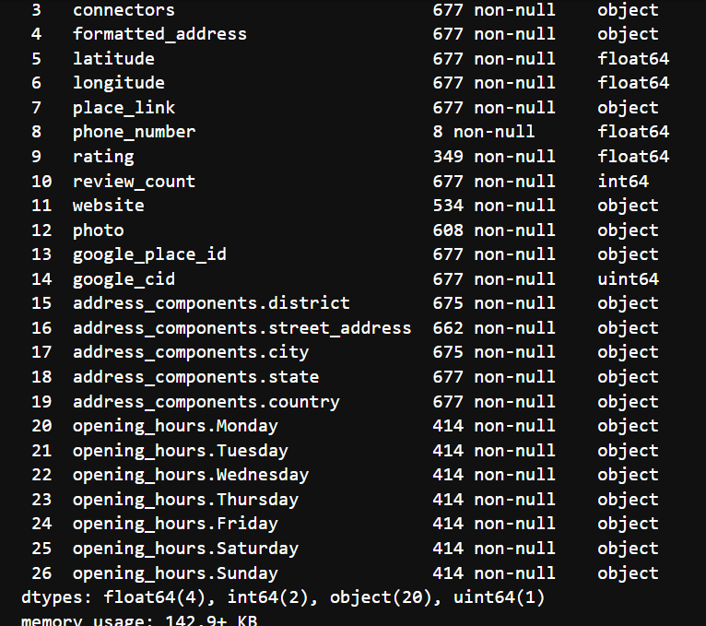
The dataset, after completing all the necessary cleaning and preprocessing steps, is now well-structured and ready for analysis

Slide 9
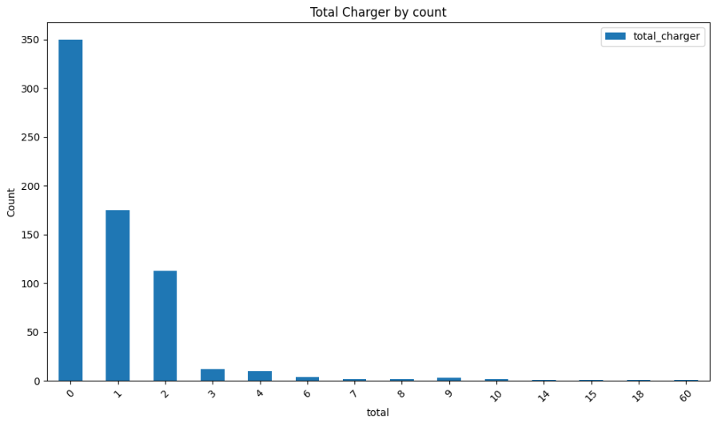
Frequency of the total Charging Station.
Observations:
The majority of charging stations fall under the category with just 1 charger.
Followed by 2 and 3 charger
Insights:
In India, most EV charging stations are equipped with only one charger.
Stations with a higher number of chargers are relatively less common.
As the number of chargers per station increases, the number of such stations gradually decreases.

Slide 10
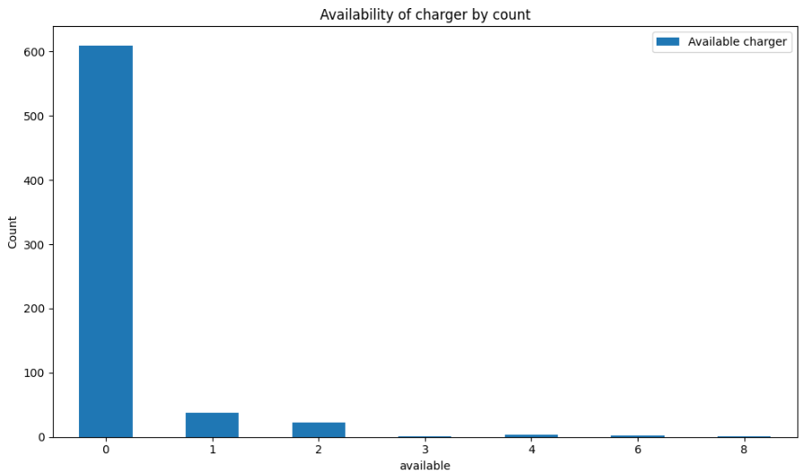
Frequency of charger availability
Observation:
A large number of charging stations report 0 available chargers.
The availability of chargers drops sharply beyond 1, with only a few stations showing 1 or more chargers available.
Insights:
There is a critical shortage of available chargers in most EV stations, indicating possible high usage or poor maintenance.
Immediate action is needed to increase the availability.

Slide 11
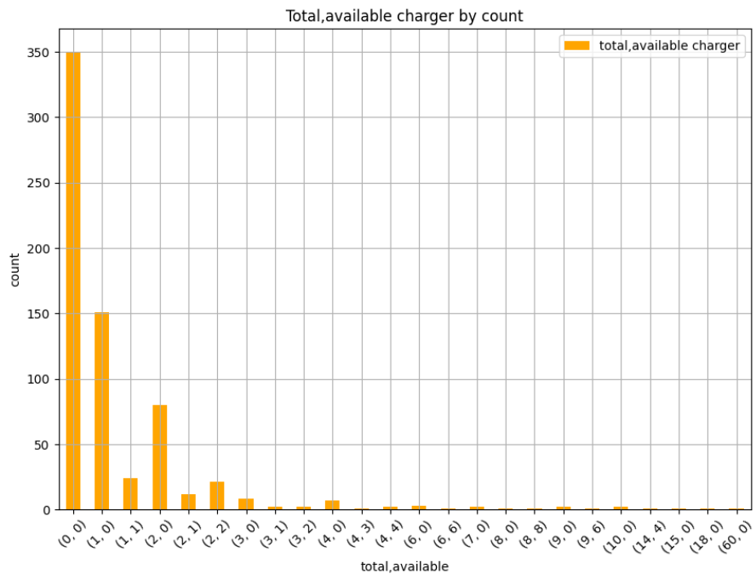
Total no of Charger and it availability
Observations:
The highest frequent is (1, 0), indicating one charger installed but none available at the moment.
Combinations like (10, 0), (14, 4), or (60, 0) are extremely rare ie ranges (1-5)
Insights:
A large number of stations either lack chargers entirely or have non-operational/unavailable chargers, which reflects inefficient infrastructure or maintenance issues.
Even among stations that have chargers, availability is often limited.

Slide 12
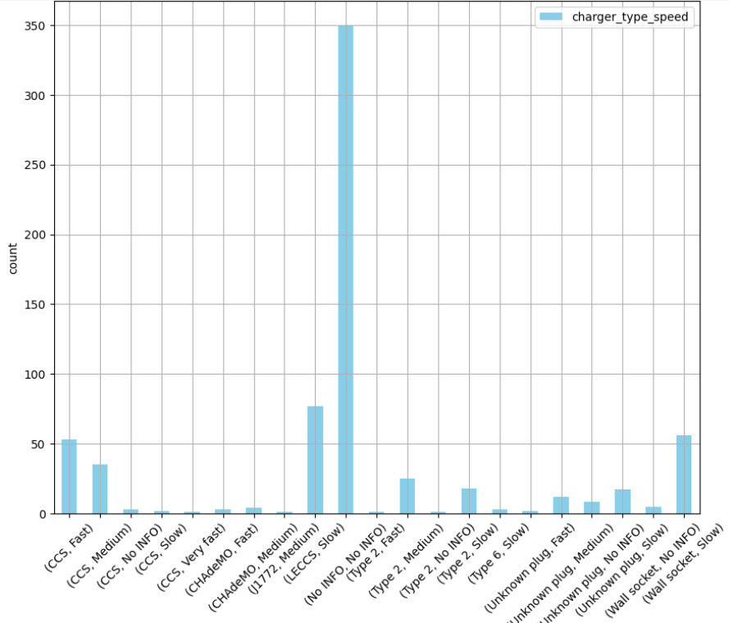
Charger Type and its Speed
Observations:
(Wall socket, Slow) and (CCS, Fast) are the most common among identified charger types, ranges from (50-70)
Types like (CHAdeMO, Fast), (Type 2, Medium), and (CCS, Very Fast) appear very few times(5-10)
Insights:
Among known and modern standards, CCS Fast chargers lead in count.
Many entries like (Wall socket, Slow) and (LECCS, Slow) suggest slow chargers are more common

Slide 13
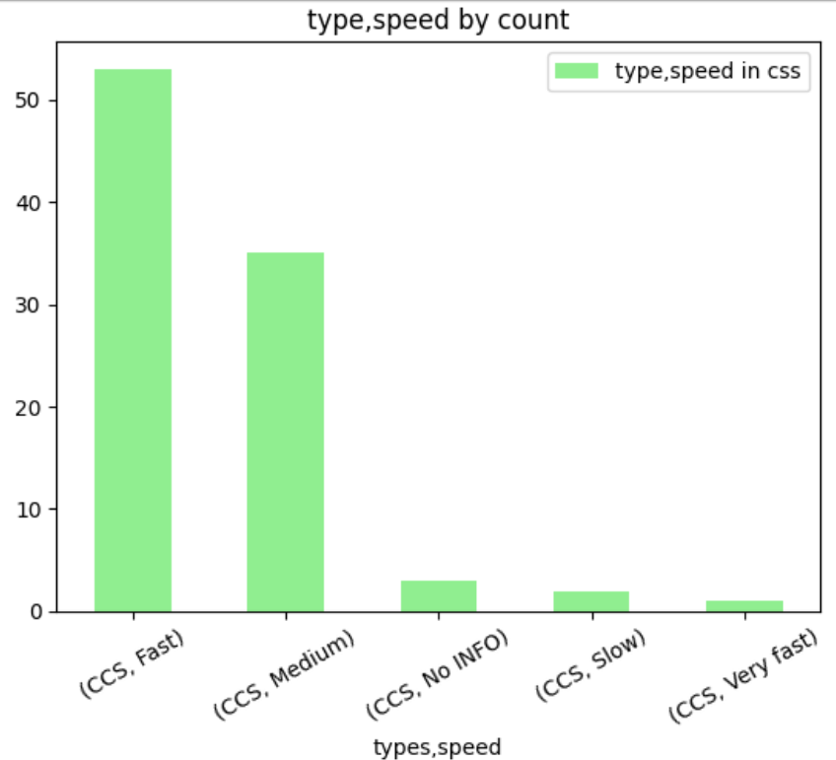
CCS charger type and its charging speed.
Observation:
Most CCS chargers fall under the 'Fast' category ie 50+
A significant number are 'Medium' speed chargers, ranges from 30-40.
Very few chargers are 'Slow', 'Very fast', or have 'No INFO' on speed in the range(1-5)
Insights:
Fast CCS chargers are the most commonly deployed, indicating a preference or demand for quicker charging solutions.
There’s an underrepresentation of high-speed (Very fast) and slow chargers.

Slide 14
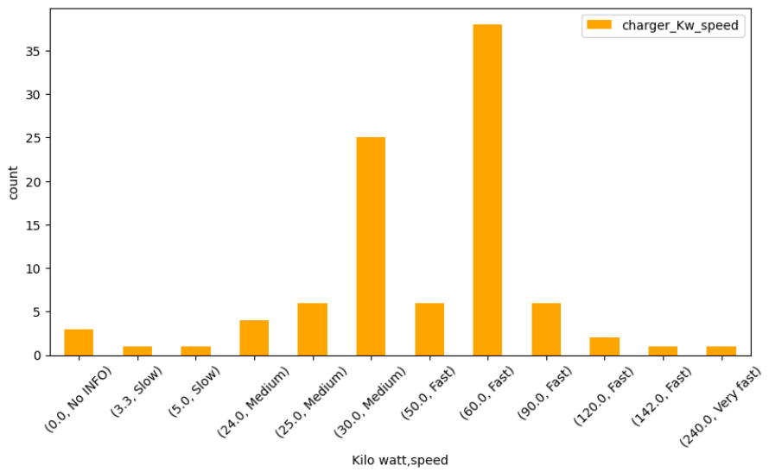
Charging Speed per Kilo-watt
Observations:
The most frequently occurring charger is (60.0 kW, Fast) with the highest count(37), followed by (30.0 kW, Medium) with around 25 entries.
Chargers rated at 90.0 kW, 120.0 kW, 142.0 kW, and 240.0 kW (Fast/Very Fast) exist but are very few in number (each < 6).
Insights:
60 kW Is the Preferred Fast Charging Standard
Mid-Range (30–50 kW) Chargers Are Also Popular
30 kW (Medium) and 50 kW (Fast) chargers have notable presence, reflecting medium-speed options.
Ultra-Fast Chargers (90 kW and above) Are Underutilized

Slide 15
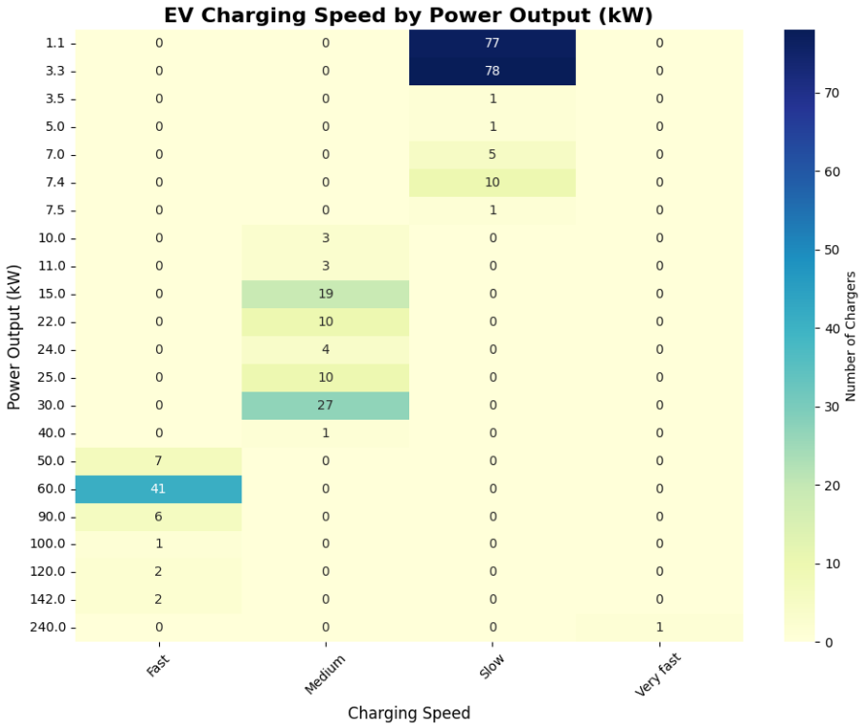
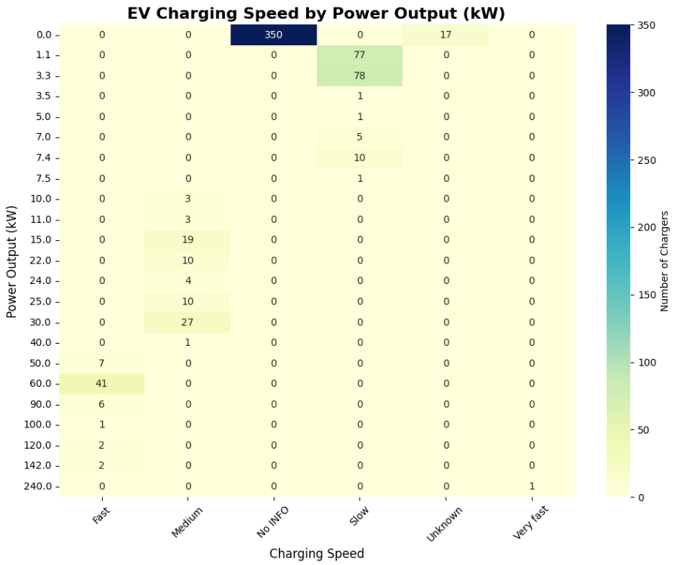
Charging Speed per Power Output
Observations:
3.3 kW (78 chargers) and 1.1 kW (77 chargers) are the most frequent chargers under Slow charging.
30.0 kW (27 chargers) is the most popular Medium speed charger.
Followed by 15.0 kW (19) and 25.0 kW (10) chargers.
60.0 kW (41 chargers) dominates the Fast charging category.
Only one charger is listed under Very Fast, with a 240.0 kW power output.
Insights:
The significant presence of 60.0 kW fast chargers suggests growing infrastructure to support quicker EV charging — ideal for commercial or urban locations.
The bulk of chargers remain in the low-power, slow category, which may reflect older infrastructure, cost concerns, or targeting residential/low-use cases.
Very Fast Charging Yet to Scale

Slide 16
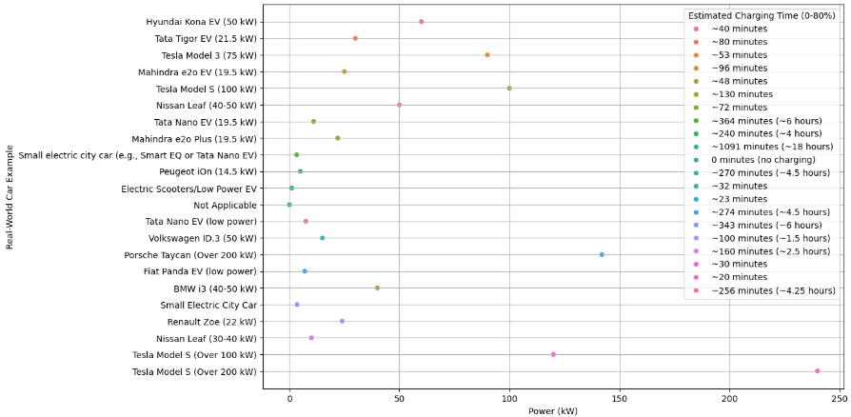
Charging Duration taken by different Vehicles(reference)
Observations:
The Tesla Model S using Over 200 kW takes only ~20–30 minutes, whereas low-power vehicles
Mahindra e2o Plus with 3.5 kW power take an exceptionally long time (~1091 minutes or ~18 hours)
Cars and scooters with <5 kW power (e.g., Tata Nano low power, electric scooters) show charging times ranging from 4–6 hours
Insights:
Faster chargers are game changers
If your car supports high charging speeds but you only have access to low-power stations, your fast car won’t be fast to charge.

Slide 17
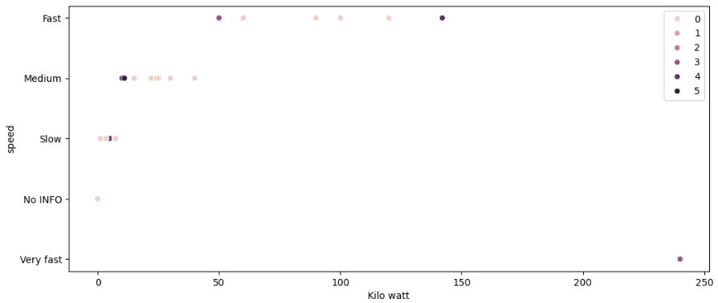
Energy consumption per speed
Observations:
The x-axis shows energy consumption ranging from 0 to 250 kilowatts (kW).
Insights:
It gives the correlation between speed and kilo watt, were speed is directly proportional to kilowatt.

Slide 18
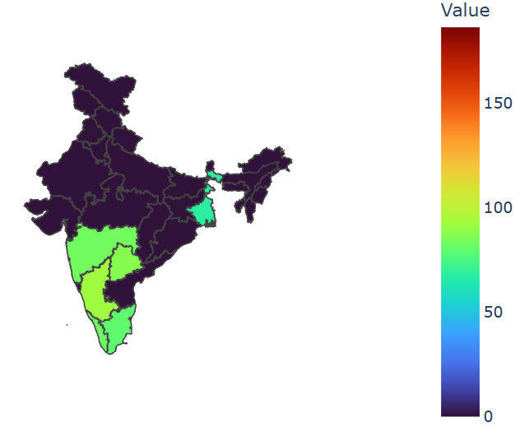
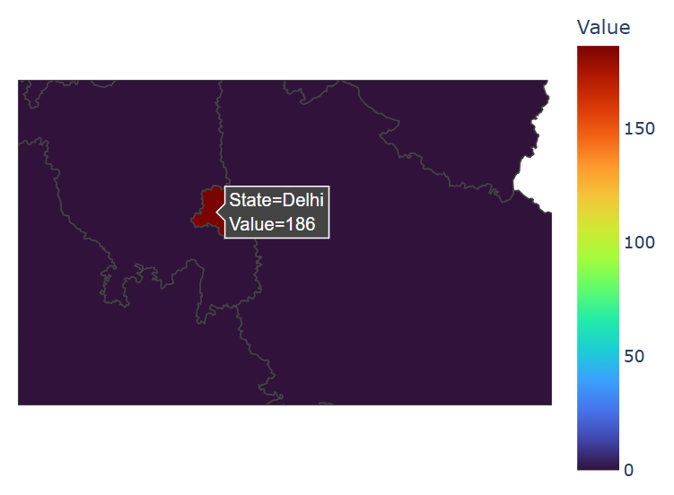
Charging station spread across different state
Observations:
Delhi has the highest number of EV stations ie, 186
Kolkata have the lowest number of stations ie, 68
Bengaluru, Mumbai, Hyderabad, Chennai, Kochi fall in the range of (80-92).
Insights:
Delhi’s leading position reflects strong policy support and high EV adoption, setting a benchmark for other cities.
Kolkata has less ev station compared to all other cities.
Bengaluru, Mumbai, Hyderabad, Chennai, Kochi EV stations are in the similar frequency.

Slide 19
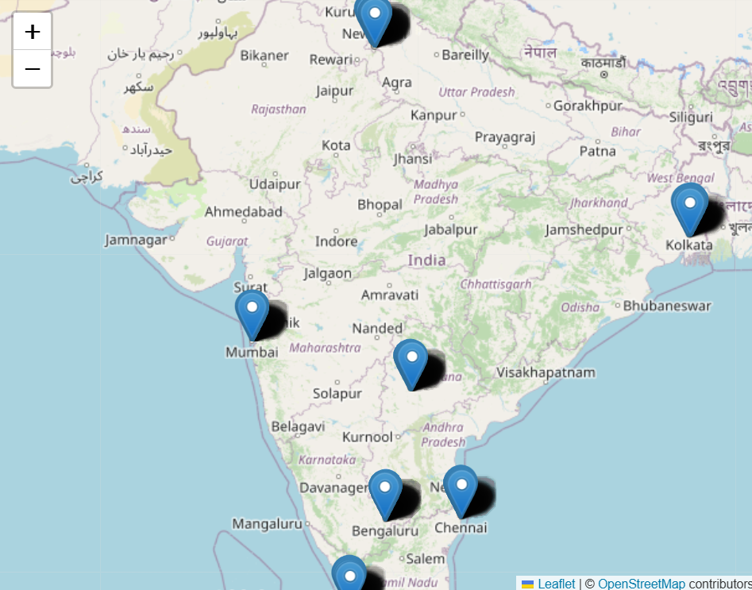
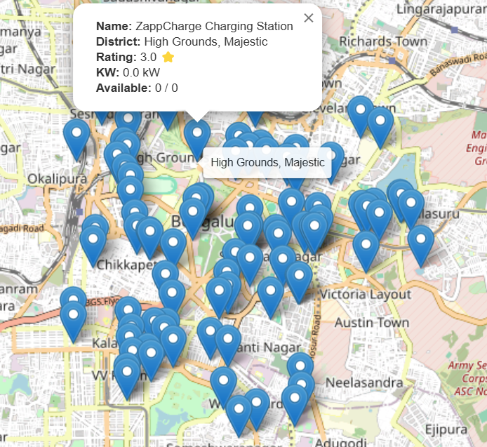
All EV charging station across India
Observations: This map highlights all the EV charging stations located in major cities across India.
It also provides a description for each charging station
Insights: Users can make informed decisions based on factors like charging type, availability

Slide 20
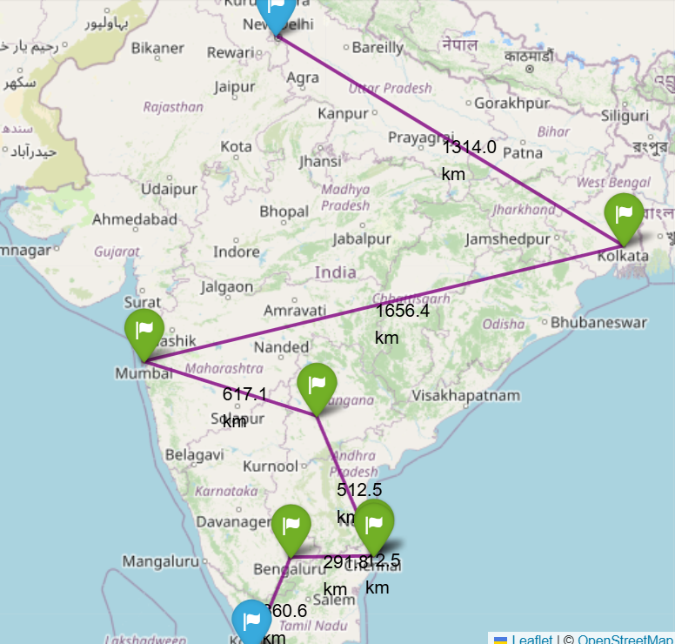
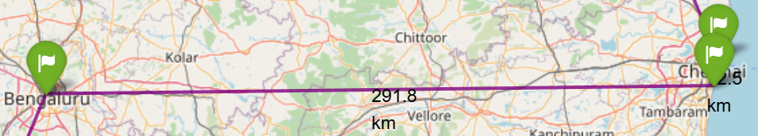
Route from Kochi to Delhi
Observations:
This map highlights the most efficient route from Kochi to Delhi. Insights: Travelers can confidently plan a road trip from the south to the north of India without worrying about running out of charge

Slide 21
Conclusion:
Highest number of Charging station present in Delhi.
CCS (fast) charger type is used in most of EV cars & heavy vehicles.
“Slow” and “medium” speed charger most likely used in 2 wheeler and 3 wheeler.
India's highest-capacity EV charger delivers up to 240 kilowatts.
Charger category “fast” ranges from (50-150Kw) is highly recommended.
As the charger speed increases time consumed to charge decreases.

Slide 22

THANK YOU

